Slide 1
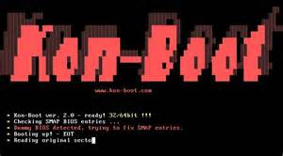
xBoot Making a multi boot USB with Kon-Boot and OphCrack
By
David Lauer

Slide 2
About Me:
I volunteer at lots of conferences and events, NotaCon, ShmooCon, DerbyCon, ThotCon, ClevelandbSides, Security Summit, and Neoisf.
I’ve spoken at some of them too.
I run http://www.1dave1cup.com
Founding Co-Host of the now retired http://www.securityjustice.com podcast.

Slide 3
Disclaimer
Use at your own risk
Use only on machines you have legal access to
I am not a lawyer.
I speak for me and not any company or business
Do not remove this disclaimer under penalty of law. For optimum performance and safety, please read these instructions carefully. Void where prohibited. No representation or warranty, express or implied, with respect to the completeness, accuracy, fitness for a particular purpose, or utility of these materials or any information or opinion contained herein. Actual mileage may vary. Prices slightly higher west of the Mississippi. All models over 18 years of age. No animals were harmed during the production of this product. Any resemblance to actual people, living or dead, or events, past, present or future, is purely coincidental. This product not to be construed as an endorsement of any product or company, nor as the adoption or promulgation of any guidelines, standards or recommendations. Some names have been changed to protect the innocent. This product is meant for educational purposes only. Some assembly required. Batteries not included. Package sold by weight, not volume. Contents may settle during shipment. No user-serviceable parts inside. Use only as directed.
Do not eat or swallow USB drives, unless doctor recommended.
Do no evil.

Slide 4
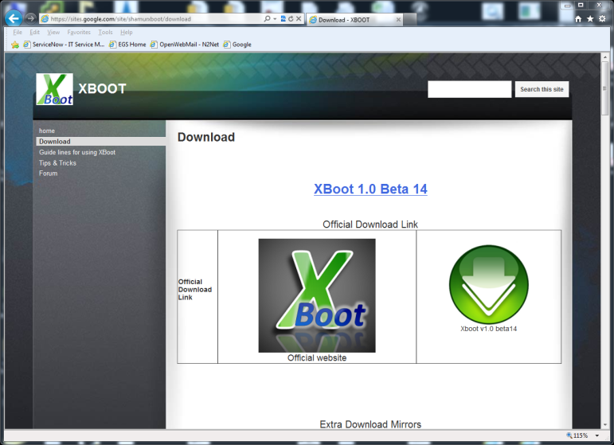
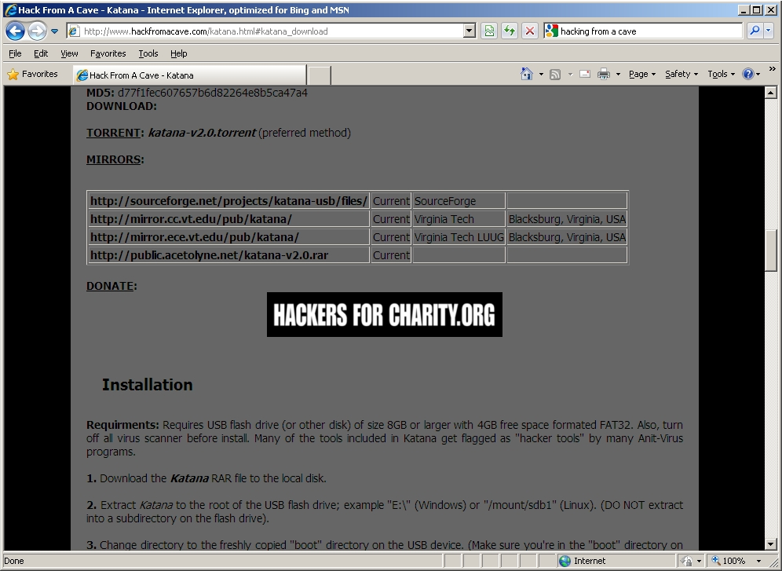
xBoot
Download xBoot at: https://sites.google.com/site/shamurxboot/download
Download the other ISO files to add to the USB drive.

Slide 5
Build the drive.
Install .Net framework 4
Format USB as Fat32
Xboot is a zip file. Unzip and run the exe.
Ready to build the Drive!

Slide 6
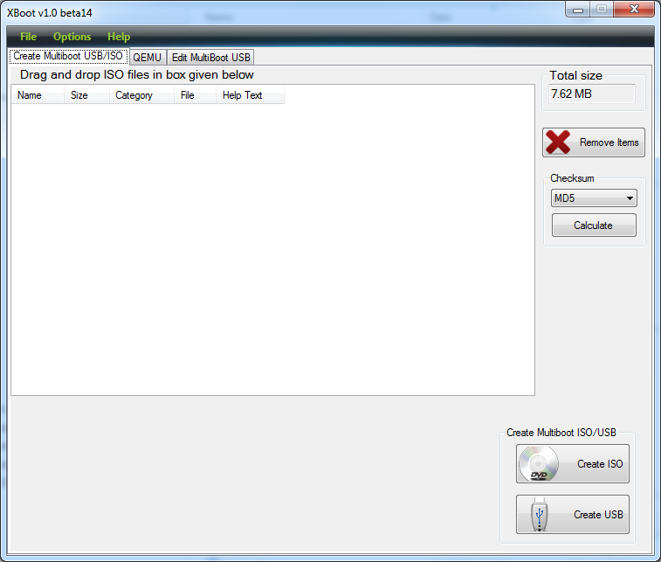
Build it
Other great guides are at:
https://sites.google.com/site/shamurxboot/home
Just Drag and Drop your ISO’s

Slide 7
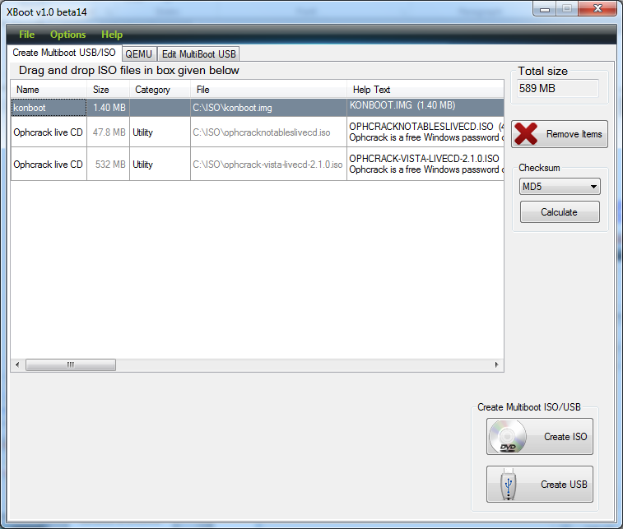
Build it.

Slide 8
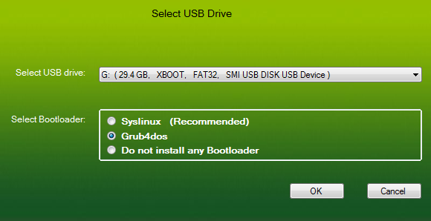
Build it..

Slide 9
Build it…
Wait!!!

Slide 10
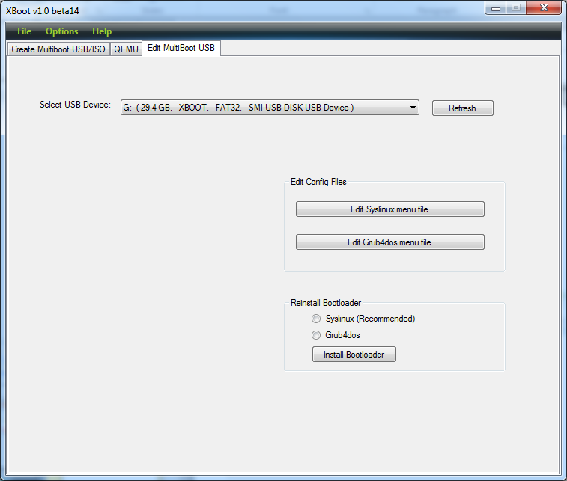
Build it….

Slide 11
Build it…..
Edit Grub4dos Menu to look like this.
### MENU START
title konboot\nKONBOOT.IMG (1.40 MB)\n
map --mem /images/konboot.img (fd0)
map --hook
chainloader (fd0)+1
map (hd1) (hd0)
map --hook
rootnoverify (fd0)
### MENU END

Slide 12
Build it……
Add your own tables to your flash drive in the
X:\tables folder. (aka directory)
This can take a while. Tables are large.
What is a table? Good question.

Slide 13
Wikipedia
http://en.wikipedia.org/wiki/Rainbow_table
"A rainbow table is a precomputed table for reversing cryptographic hash functions, usually for cracking password hashes. Tables are usually used in recovering the plaintext password, up to a certain length consisting of a limited set of characters. It is a form of time-memory tradeoff, using less CPU at the cost of more storage. Proper key derivation functions employ a salt to make this attack infeasible." - All talks must have the Wikipedia citation.

Slide 14
Your done.
Test!
Test!
Test!

Slide 15
#Fail

Slide 16
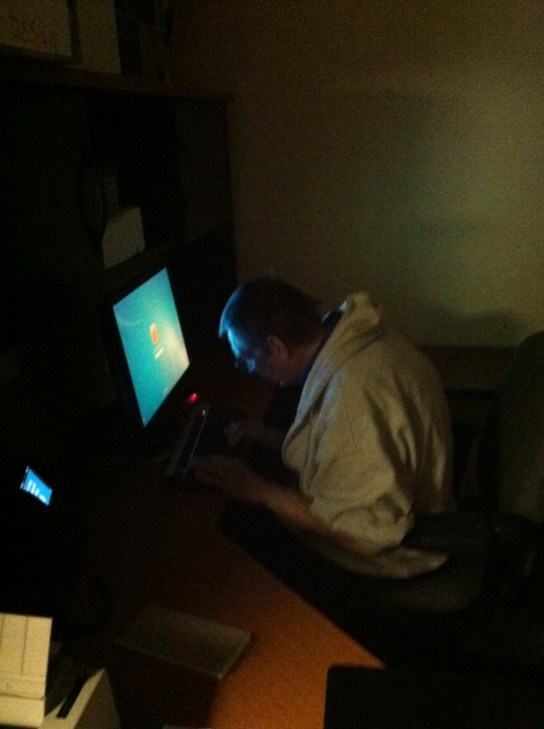
#NoFail

Slide 17
Demo Time!!
If everything goes as planned, the Demo should be shorter than the PowerPoint ☺
So let’s play.

Slide 18
OMG - Help
So how do I stop this?
FDE (Full Disk Encryption)
Lock the BIOS
No Booting from USB
No Booting from CD/DVD
Lock the CPU case

Slide 19
Thursday Night Notacon Freeview
Starting at 7:00 PM at the Marriott East in Beachwood, OH
Interested in learning more about Notacon, PixelJam and this year’s presentations, but don’t want to buy a ticket until you know more? Attend our annual Thursday Freeview and hear five minute lightning previews from some of our presenters! As the name implies, it is completely free to attend. For an added bonus, you get to see some of the behind-the-scenes work that goes into making Notacon a success!
So come by Thursday, April 12th at around 7:00 PM and learn more about what makes Notacon a truly unique event. Freeview attendees also receive a reduced admission price to all of Notacon and PixelJam!

Slide 20
Thank You
Questions?
https://sites.google.com/site/shamurxboot/
http://www.piotrbania.com/all/kon-boot/
http://ophcrack.sourceforge.net/
David Lauer
E-Mail: d@securi-d.com
Twitter: @securid
Linkedin: www.linkedin.com/pub/david-lauer/2/2b8/704/
Websites: www.1dave1cup.com www.securi-d.com

