Slide 1
Who do you see on wifi? Who sees you on wifi?
By
David Lauer

Slide 2
About Me:
I volunteer at lots of conferences and events, NotaCon, ShmooCon, DerbyCon, ThotCon, ClevelandbSides, Security Summit, and Neoisf.
I’ve spoken at some of them too.
I run http://www.1dave1cup.com
Founding Co-Host of the now retired http://www.securityjustice.com podcast.

Slide 3
Disclaimer
Use at your own risk
Use only on wireless networks you have legal access too.
I am not a lawyer.
I speak for me and not any company or business
Do not remove this disclaimer under penalty of law. For optimum performance and safety, please read these instructions carefully. Void where prohibited. No representation or warranty, express or implied, with respect to the completeness, accuracy, fitness for a particular purpose, or utility of these materials or any information or opinion contained herein. Actual mileage may vary. Prices slightly higher west of the Mississippi. All models over 18 years of age. No animals were harmed during the production of this product. Any resemblance to actual people, living or dead, or events, past, present or future, is purely coincidental. This product not to be construed as an endorsement of any product or company, nor as the adoption or promulgation of any guidelines, standards or recommendations. Some names have been changed to protect the innocent. This product is meant for educational purposes only. Some assembly required. Batteries not included. Package sold by weight, not volume. Contents may settle during shipment. No user-serviceable parts inside. Use only as directed.
Do not eat or swallow USB drives, unless doctor recommended.
Do no evil.

Slide 4
Wikipedia
http://en.wikiquote.org/wiki/Talk:Albert_Einstein
"If you can't explain it simply, you don't understand it well enough.“ - Albert Einstein
All talks must have the Wikipedia citation.

Slide 5
Audience Management IT
This is a great way to get involved.
Install the app and learn. Your IT people will be happy to help
This is a great way to spread awareness.
Help management when they ask.

Slide 6
The Goal
The goal is to get people to start talking and asking questions.
The idea is that by installing a quick app the user can see all the stuff on their network and start talking to their IT staff.

Slide 7
The Speech
Is your company wifi safe?
Want a quick way to check?
Yes, I know this is not 100% correct but it's a starting point. The point is to get people / managers to their IT people and fix the simple stuff.

Slide 8
Install
Choose the correct store to install from.
Install the program you choose.
Connect to your wireless.
Scan the network.

Slide 9
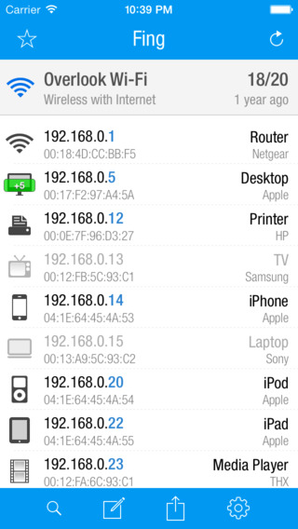
What do you see?
These are other computers, printers, or devices that are connected to the network.

Slide 10
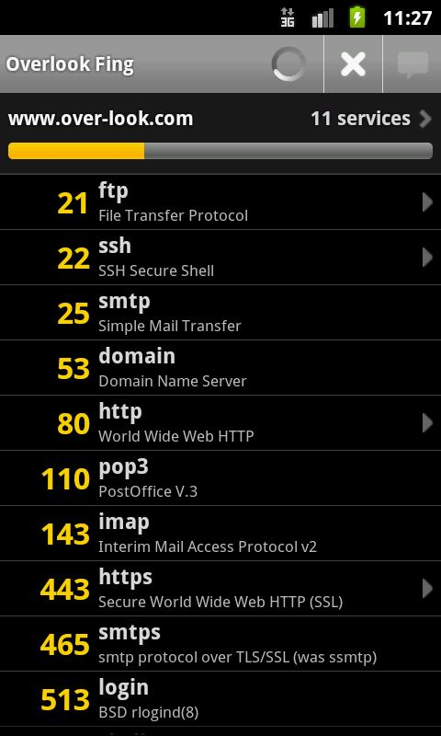
A Quick Port Scan?

Slide 11
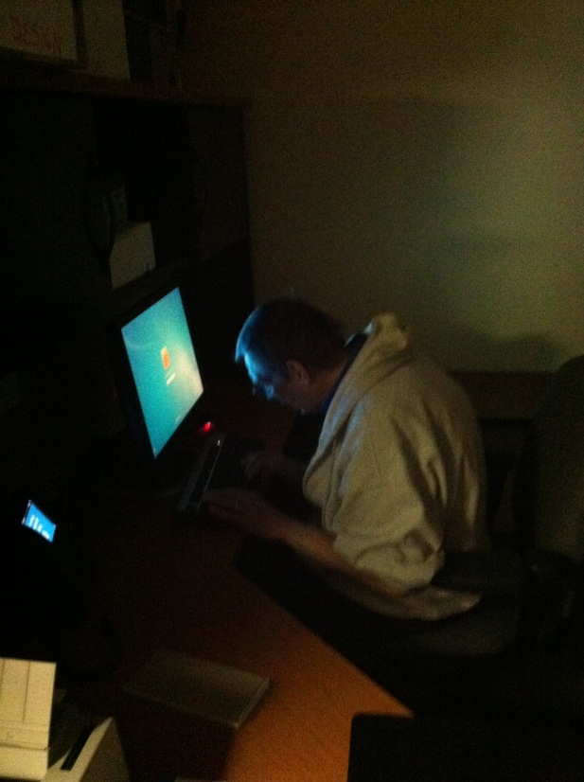
If you can see him! He sees YOU!

Slide 12
OMG - Help
So how do I stop this?
First talk to your IT staff. Do you want to stop this. You may be connecting to a network where you should see other computers.
The goal of this to get Non-Tech people to ask questions and become involved in the security process.

Slide 13
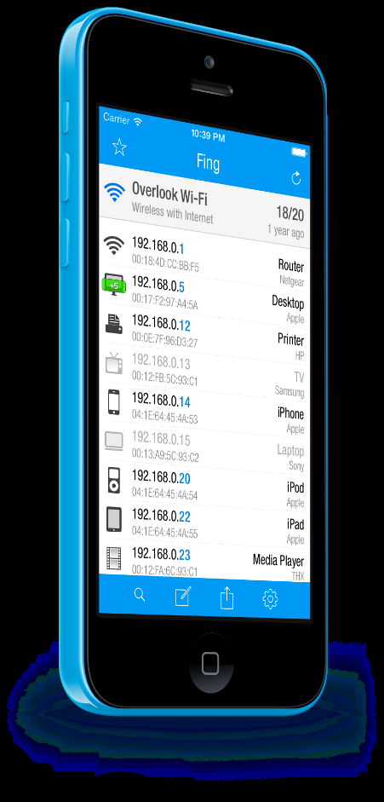
Thank You
Questions?
http://www.overlooksoft.com/fing
http://www.inetapp.de/en/inetx.html
David Lauer
E-Mail: d@securi-d.com
Twitter: @securid
Linkedin: www.linkedin.com/pub/david-lauer/2/2b8/704/
Websites: www.1dave1cup.com www.securi-d.com

